Slide 1
Plausibility and Passing:
Using LLMs to Study Anti-Trans Discourse
Filipa Calado, PhD
Assistant Professor
Pratt Institute iSchool

Slide 2
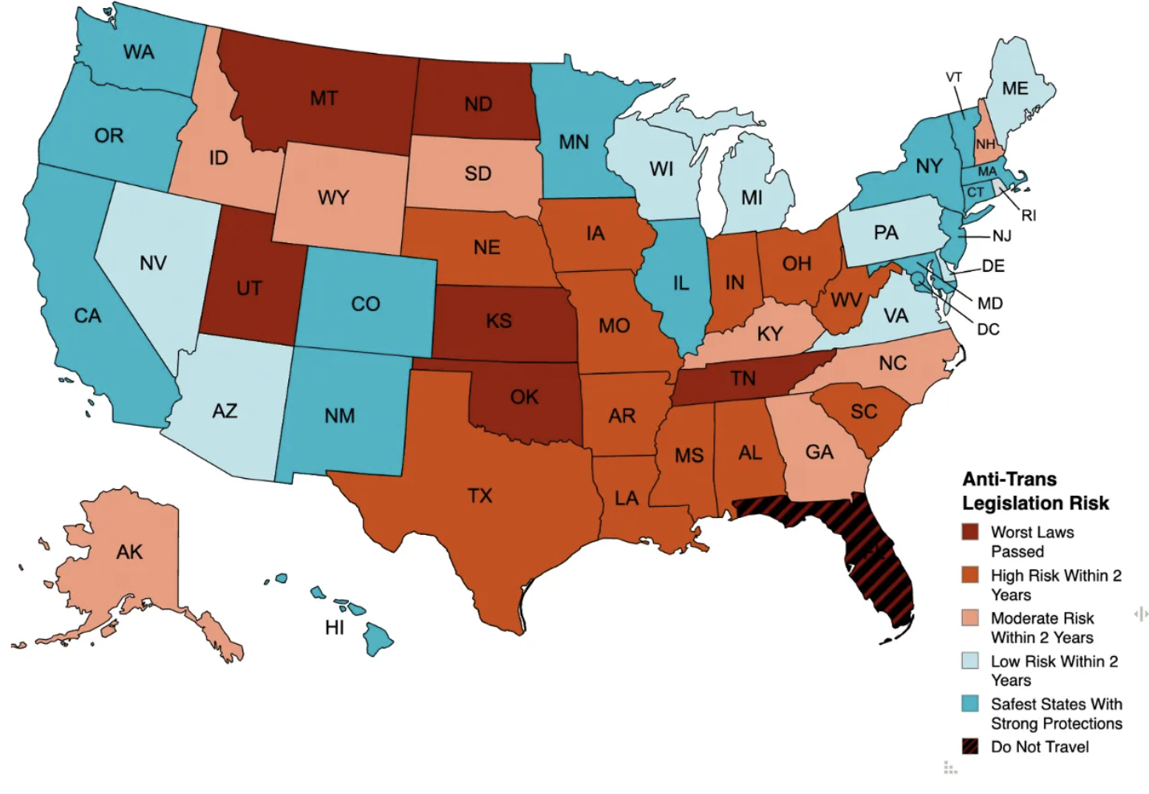
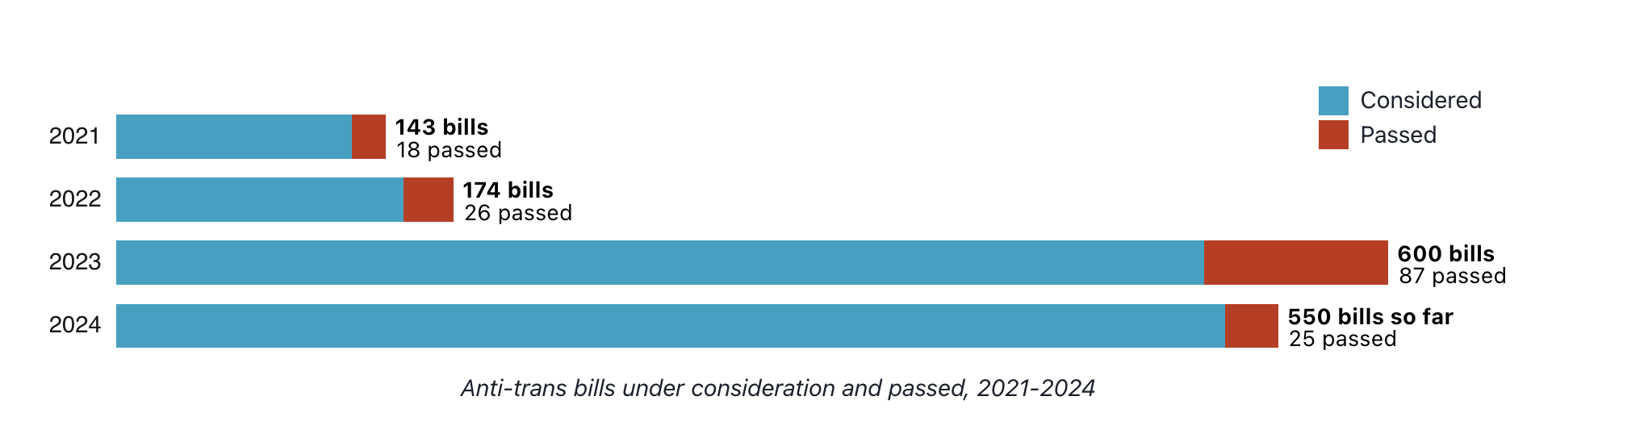
“The Adult Trans Legislative Risk Assessment Map”
Erin Reed
“Anti-Trans Legislation Tracker”

Slide 3
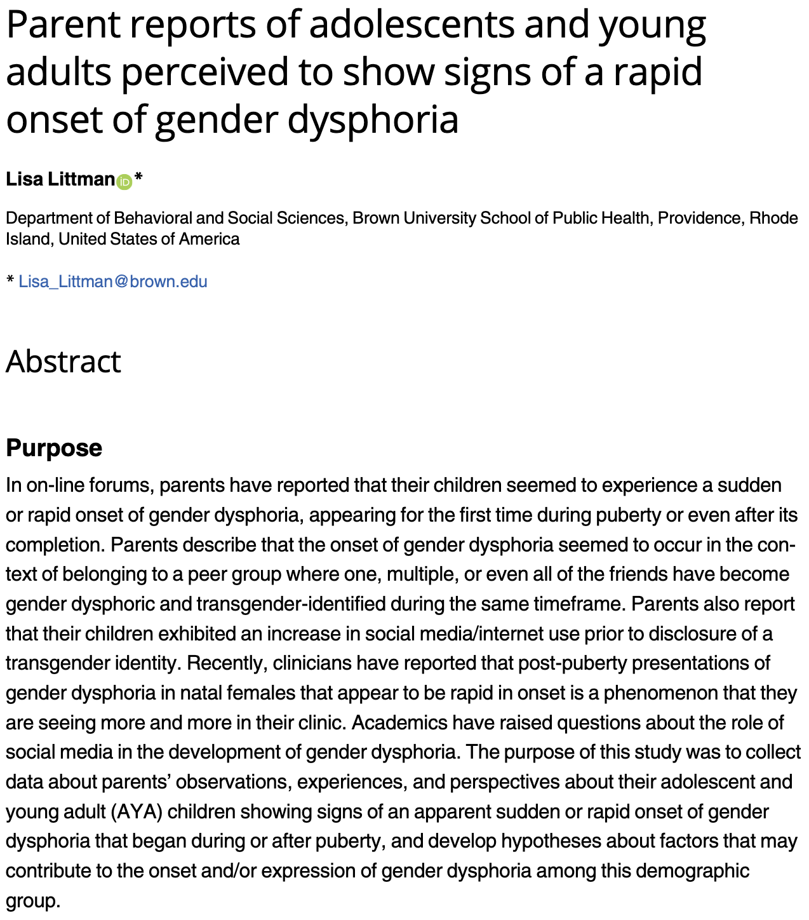

Slide 4
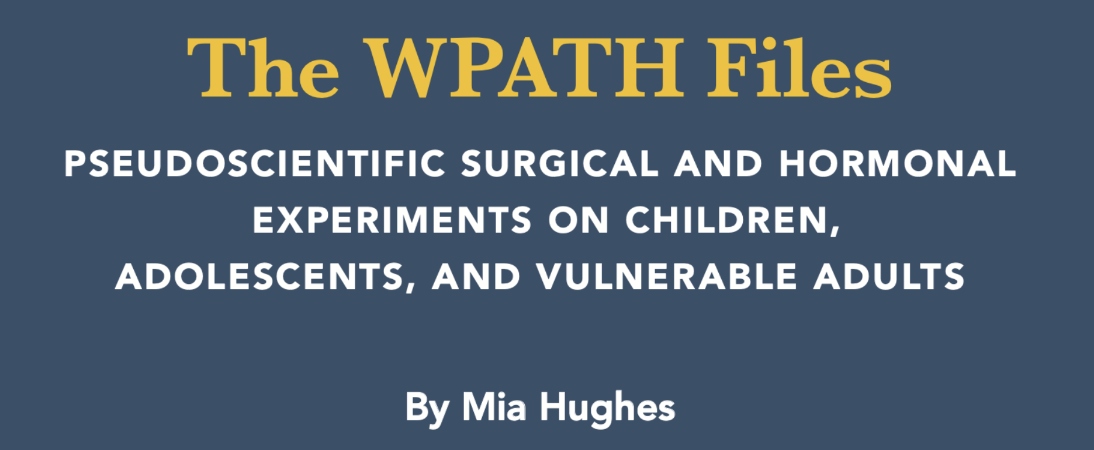
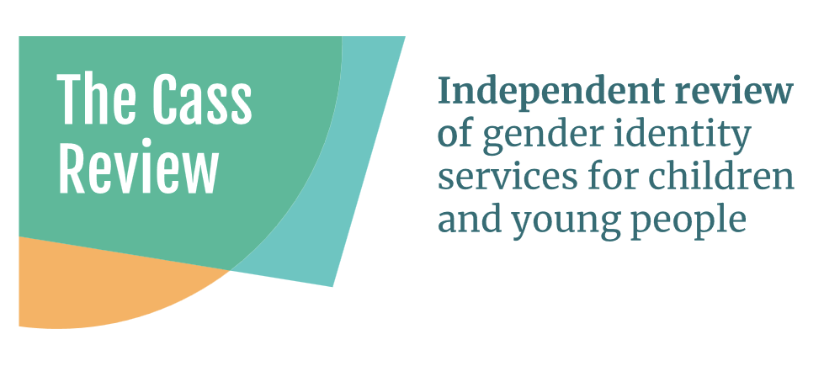

Slide 5


Slide 6
“Of course, the very prospect that their child might self-harm would bring all but the coldest parents to their knees. If adopting [his] new name and pronouns and buying [him] new opposite-sex clothing is what it takes to keep [him] alive, most parents would leap aboard the gender train… You don’t want your child to hang 'himself' in the garage just because you accidentally referred to her as ‘Rebecca’.” (103-104)

Slide 7

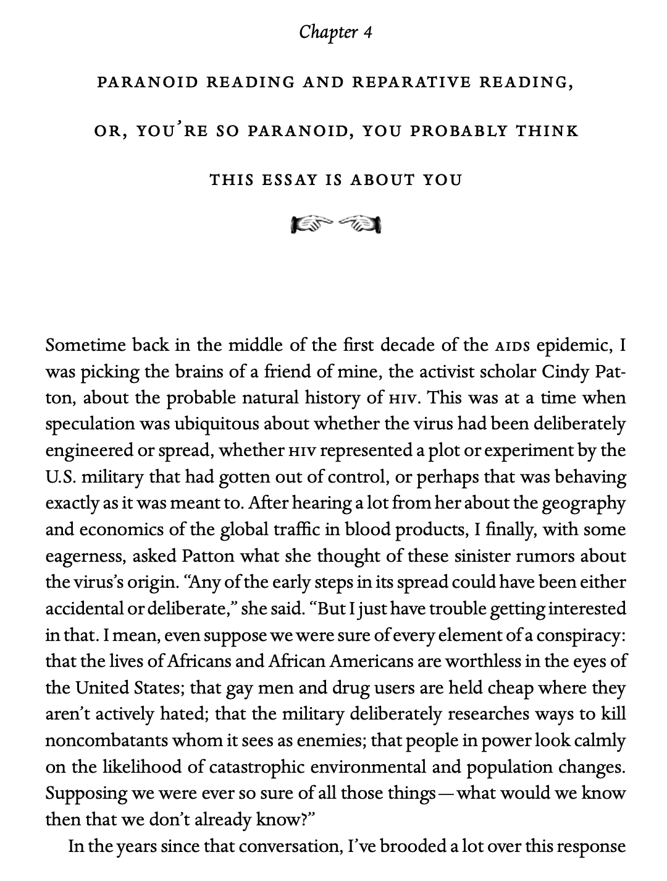

Slide 8
Eve Kosofsky Sedgwick, Touching/Feeling
“Shame--living, as it does, on and in the muscles and capillaries of the face--seems to be uniquely contagious from one person to another” (63).
“Shame... is not a discrete intrapsychic structure, but a kind of free radical that (in different people and different cultures) attaches to and permanently intensifies or alters the meaning of—of almost anything: a zone of the body, a sensory system, a prohibited or indeed a permitted behavior, another affect such as anger or arousal, a named identity, a script for interpreting other people’s behavior toward oneself” (62)

Slide 9
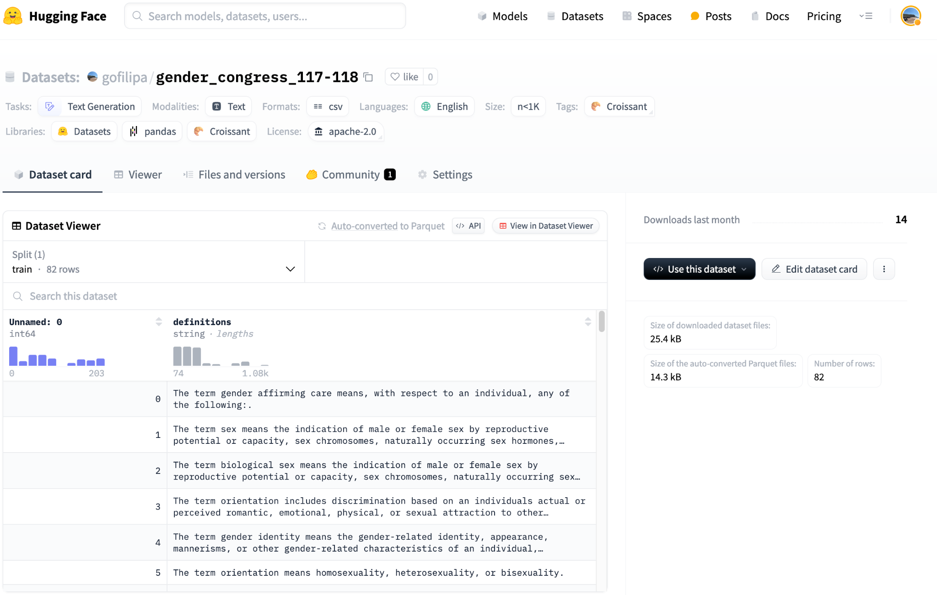

Slide 10
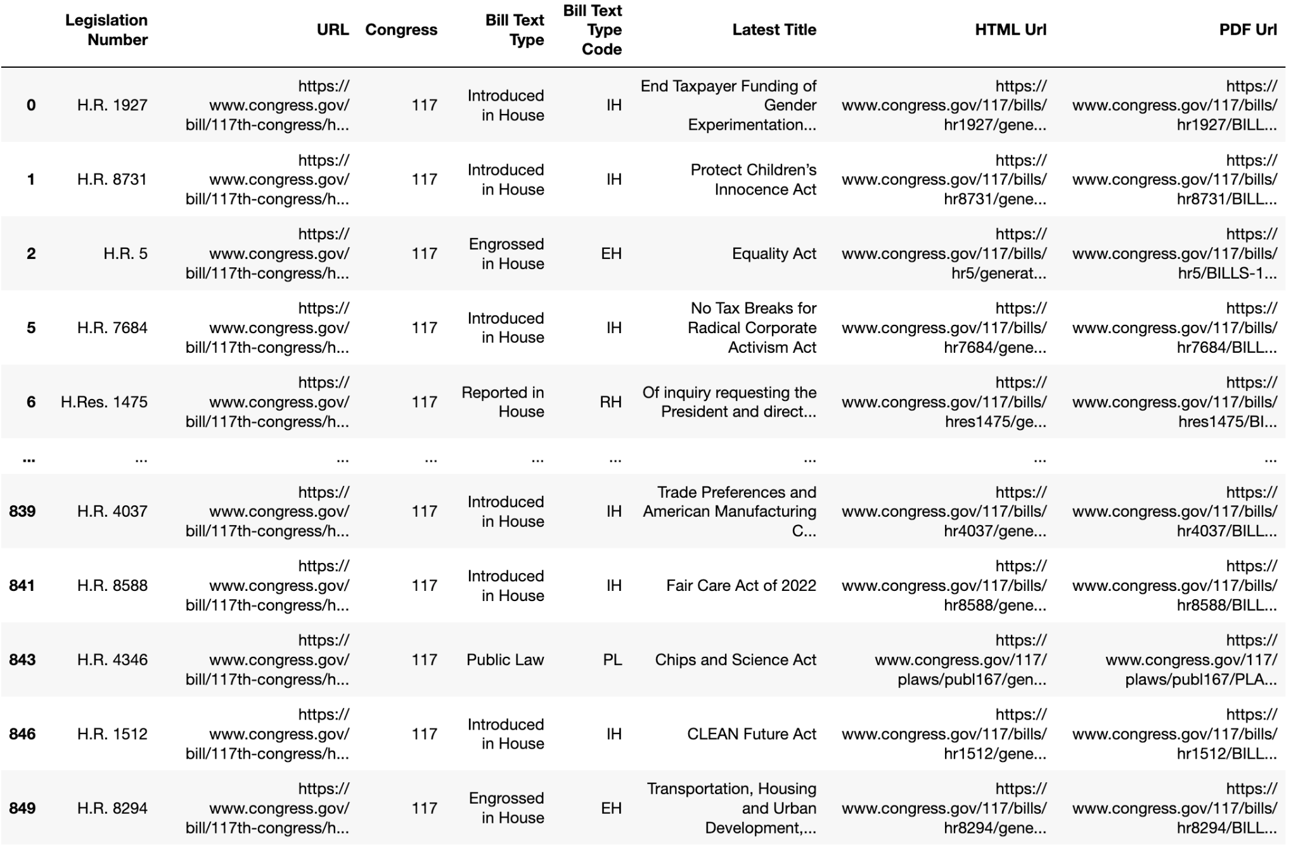

Slide 11
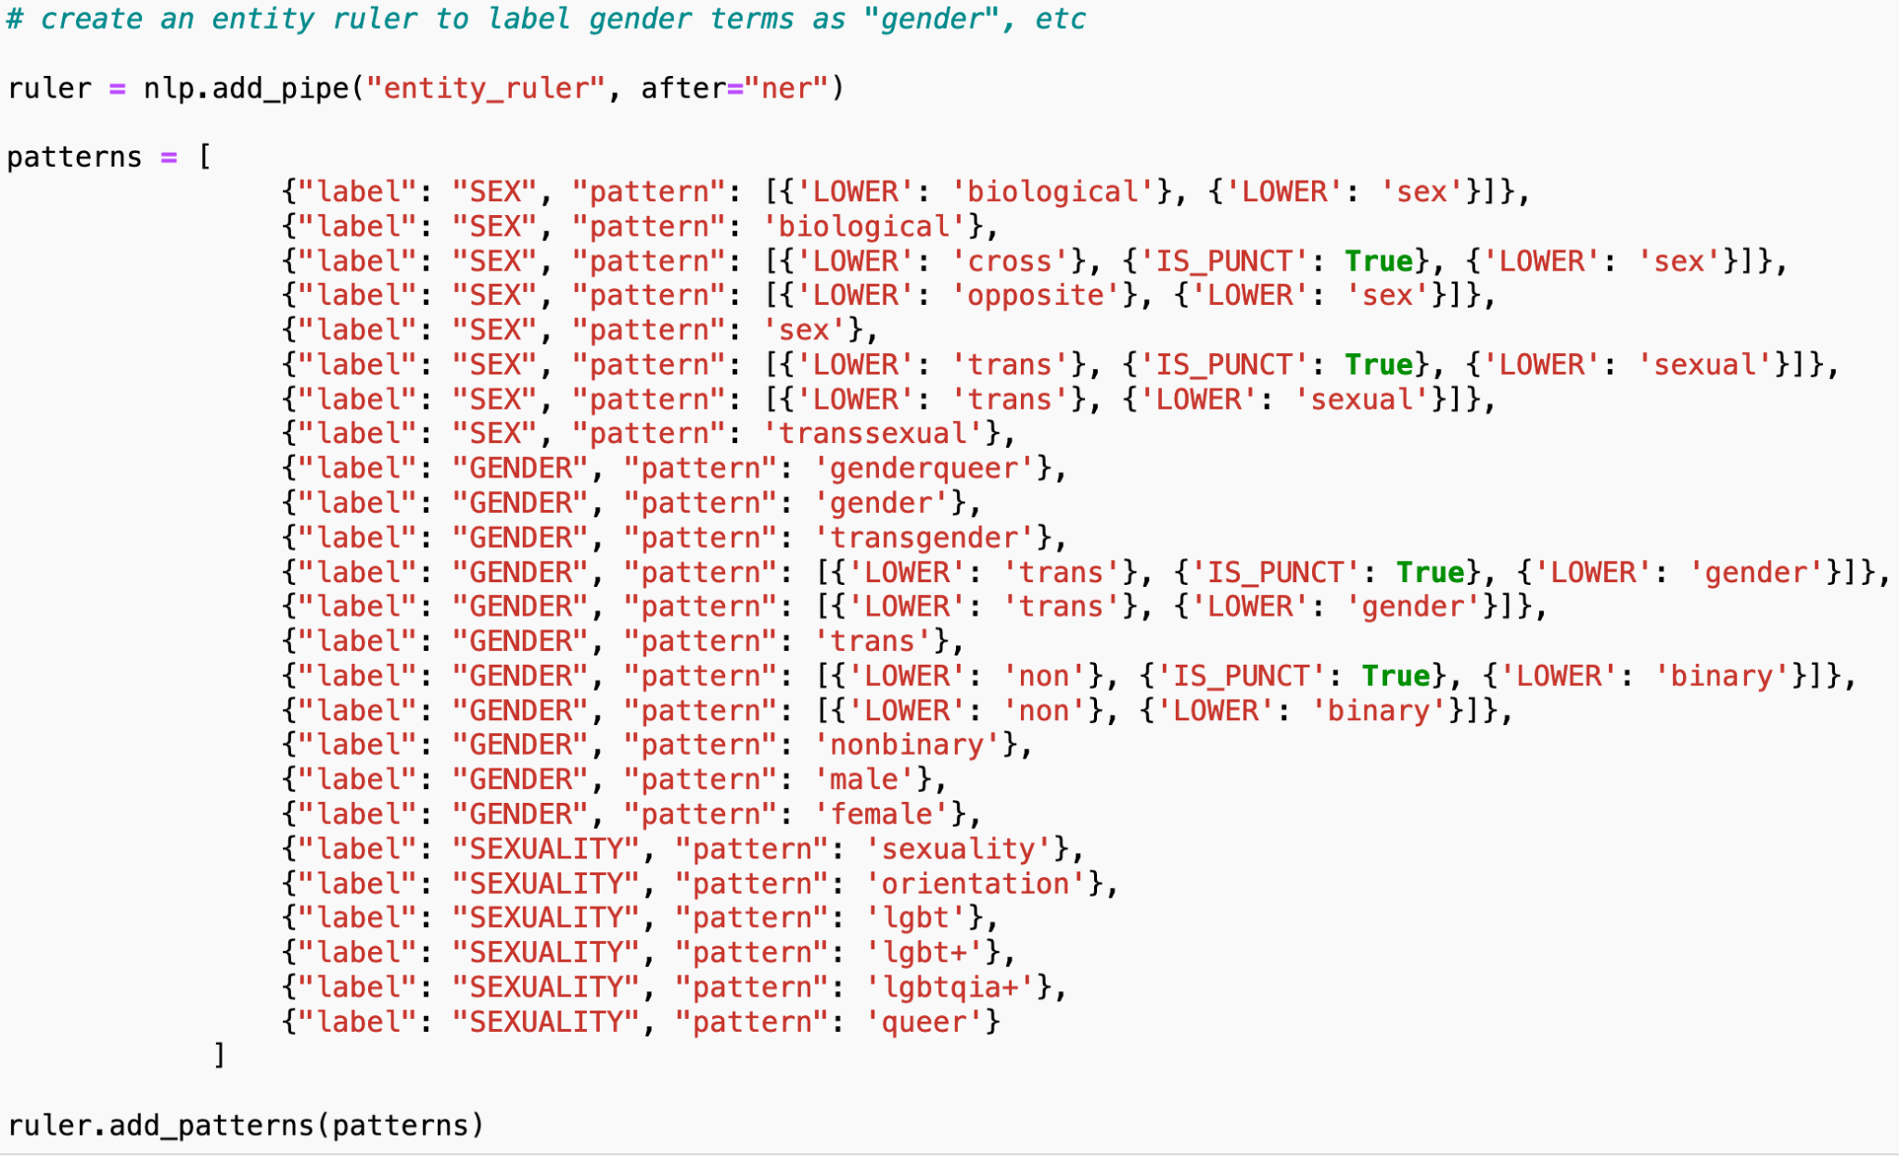

Slide 12
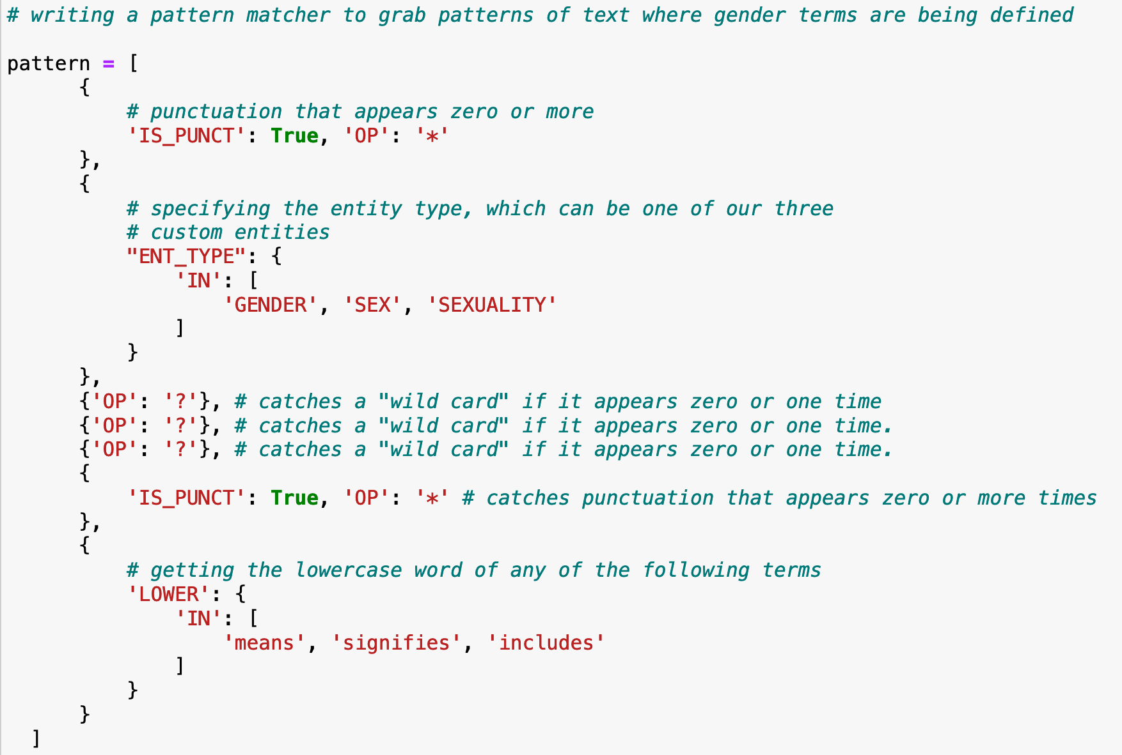

Slide 13
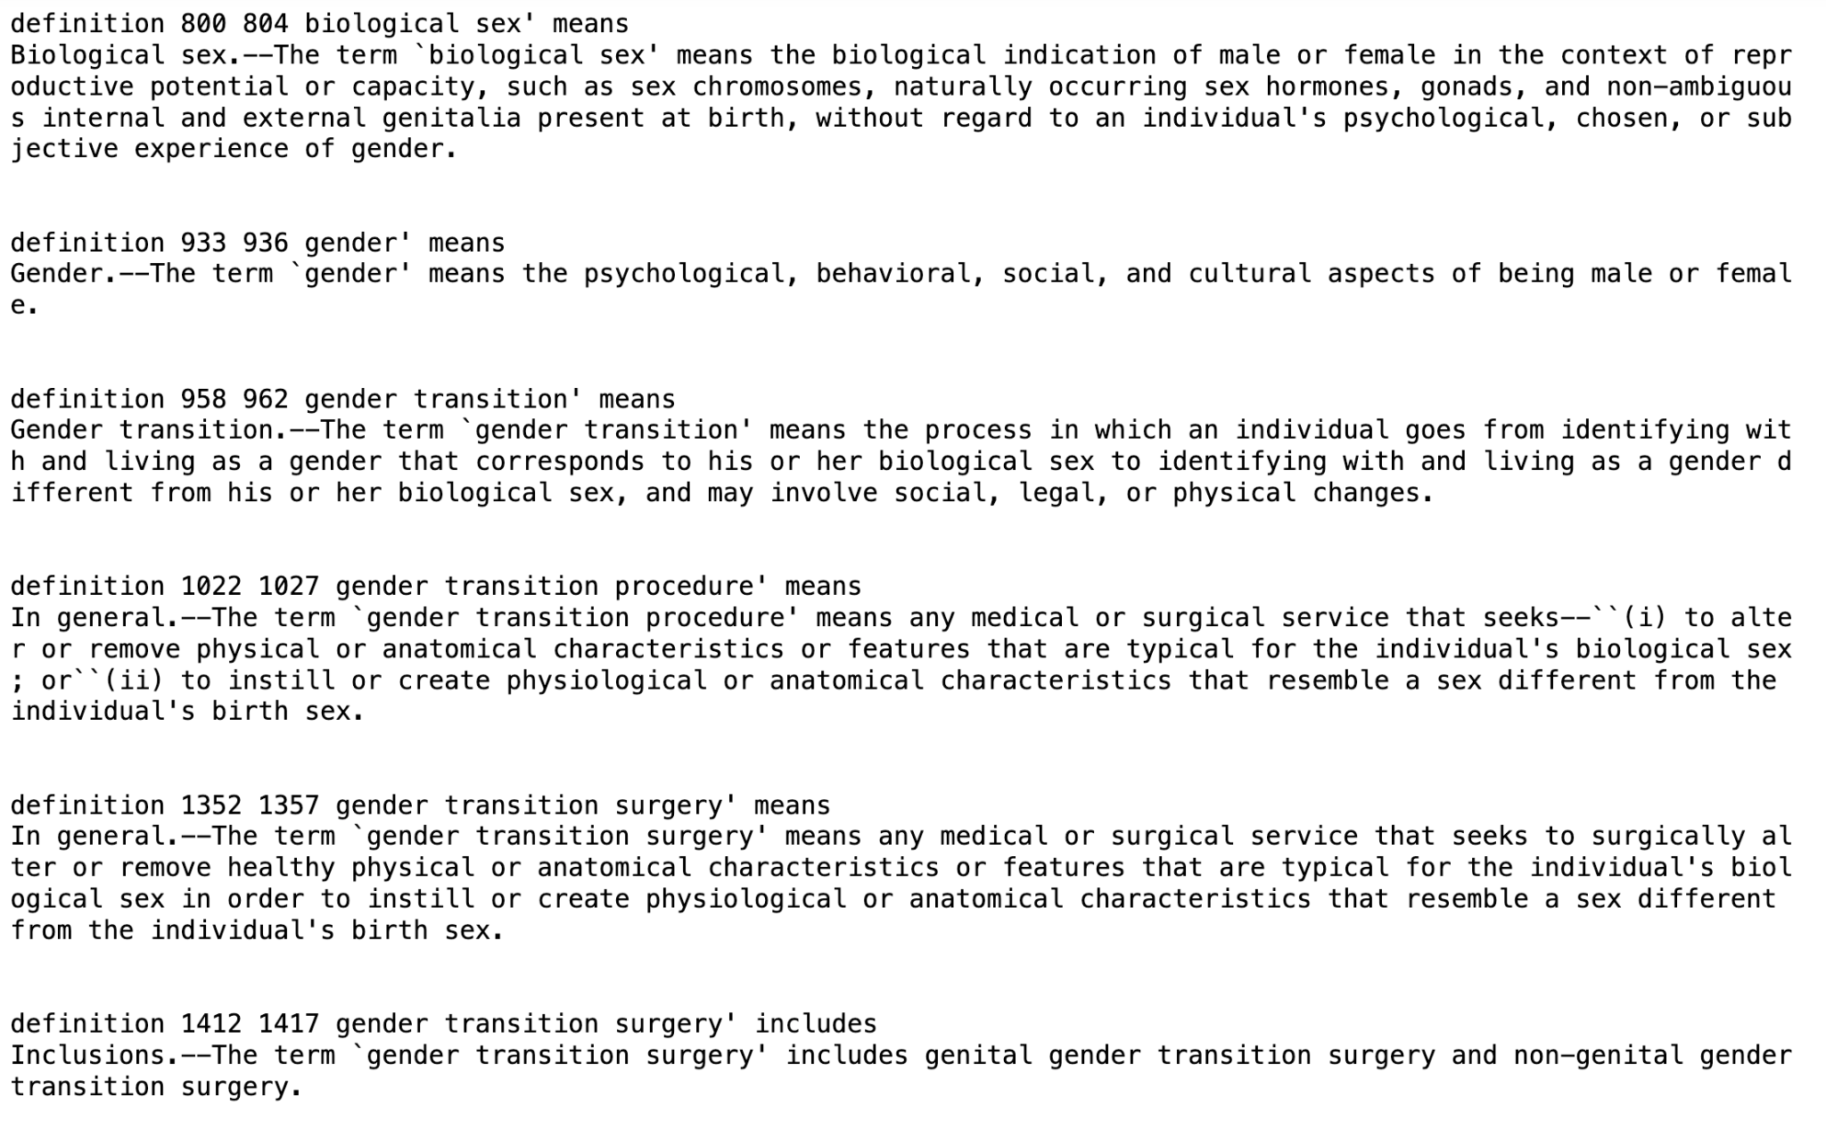

Slide 14
The term gender identity means a person’s self-perception of their gender or claimed gender, regardless of the person’s biological sex.
The term gender means the psychological, behavioral, social, and cultural aspects of being male or female.
The term gender transition means the process in which an individual goes from identifying with and living as a gender that corresponds to his or her biological sex to identifying with and living as a gender different from his or her biological sex, and may involve social, legal, or physical changes.
The term biological sex means the indication of male or female sex by reproductive potential or capacity, sex chromosomes, naturally occurring sex hormones, gonads, or internal or external genitalia present at birth.

Slide 15
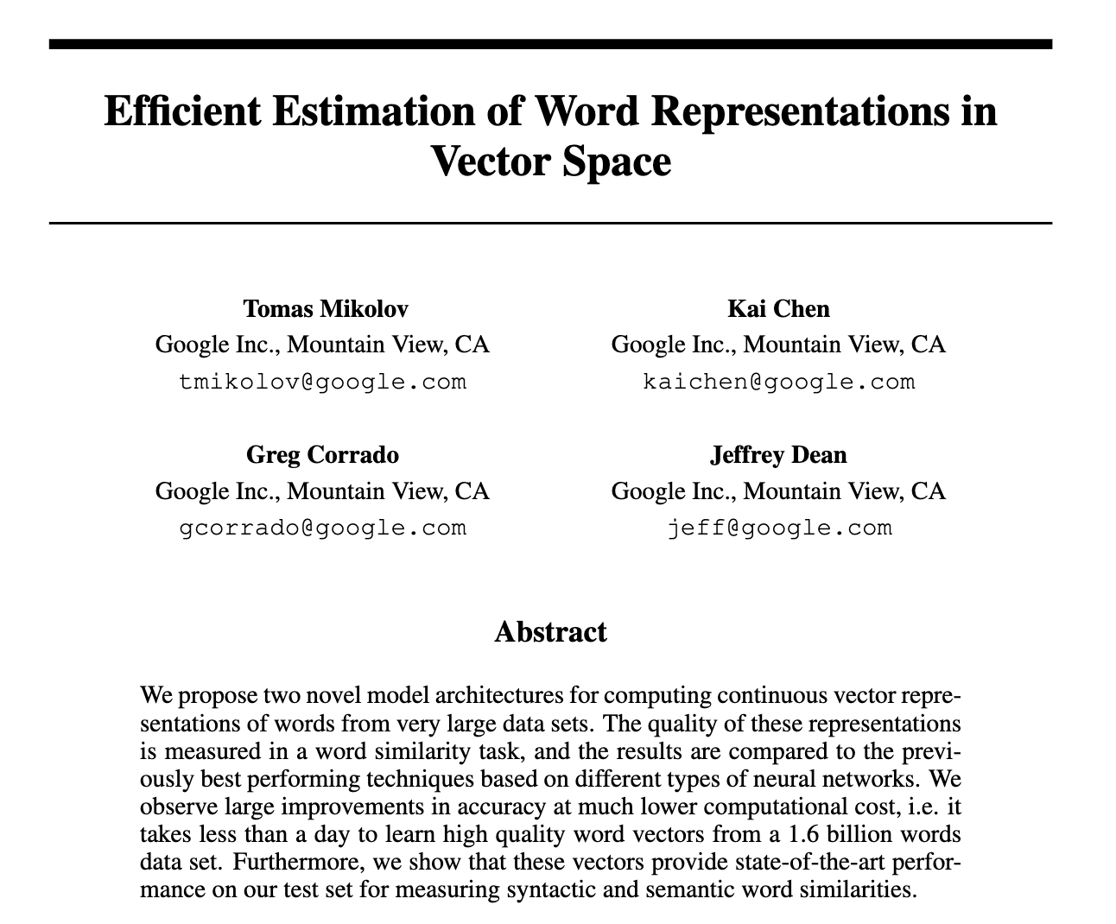
King - Man + Woman = Queen

Slide 16
Training process
Hypothesis function
Prompted with “woman,” predicts “flies.”
Loss function
Calculates difference between prediction, “flies,” and actual result, “sings”
Minimizing loss function (gradient descent)
Shifts vectors ever so slightly and iteratively until it has the correct vectors for “sings”

Slide 17
Being transgender means an individual who is recognized as a transgender on the date of the transgender event and may involve social legal or physical changes. The term transgender means an individual who is recognized as a transgender on the date of the transgender event and may involve social legal or physical changes. The term transgender means an individual who is recognized as…
Gender affirmation is a testosterone or other androgens given to biological females at doses which are profoundly larger or more potent than would normally occur naturally in healthy biological females and estrogen given to biological males at doses which are profoundly larger or more potent than would normally occur naturally in healthy biological males and estrogen given to biological males at doses which are profoundly larger or more potent than would normally occur naturally in health…

Slide 18
Thank you
gofilipa (GitHub, HuggingFace & Gmail)

